Slide 1
Temperature & Humidity Sensing
Jason Pearson • Justin Koehler • Marcel Englmaier

Slide 2
Introduction
Background
Design Decisions
Design
Implementation
Testing
Security
Maintenance

Slide 3
Background

Slide 4

Background - Client
Western Michigan University
Dr. John Kapenga
CS Department
CAE Center

Slide 5
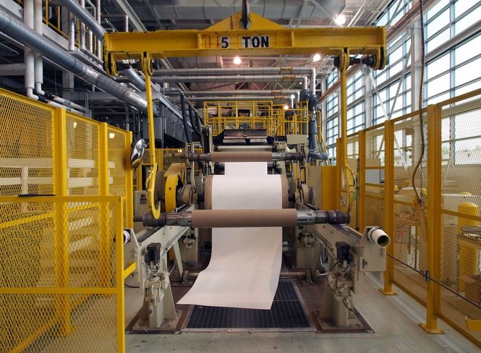
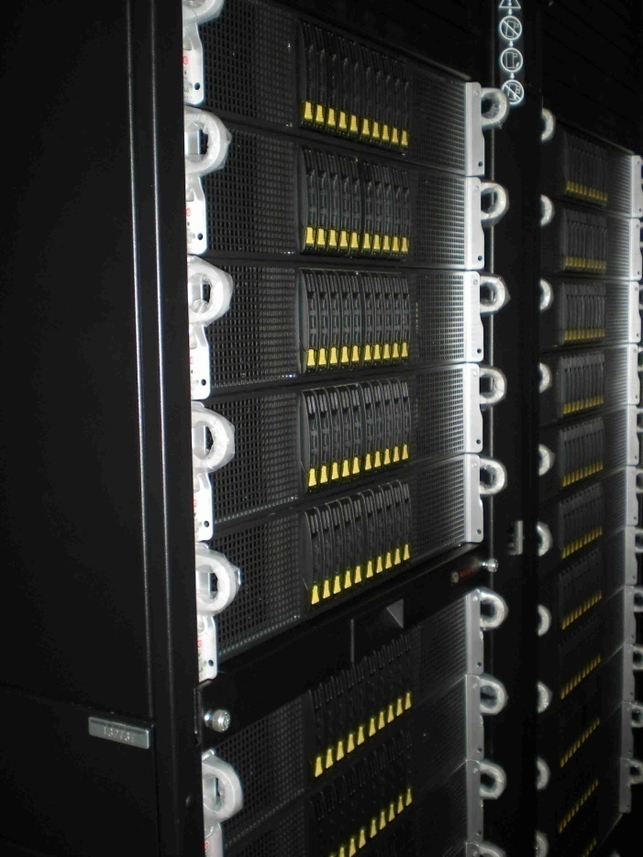
Background – Issues
Problems with temperature and humidity in the past
$500,000 worth of equipment lost due to lack of sensing/alerts
$50,000 paper roller lost due to oxidation from humidity

Slide 6
Background – Issues
Problems with temperature and humidity in the past
$500,000 worth of equipment lost due to lack of sensing/alerts
$50,000 paper roller lost due to oxidation from humidity

Slide 7
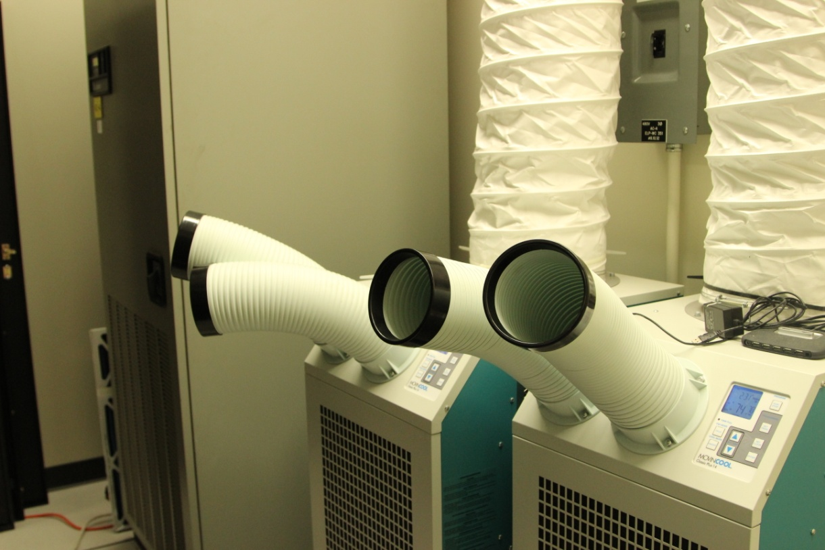
Background – Why it Matters
Current server rooms only have one HVAC per room
2 is optimal for redundancy
Quick response system is needed for protection
1 hour max delay before critical emergency
Any increase in temperature reduces life expectancy of equipment
Notes:
redundancy
2 havc’s – explain that they had an issue in a room with 1 hvac – it had to be replaced, have to shut the whole server down for a weekend, if they had 2, 100% uptime
2 hvac’s – if one fails, it keep the room cool

Slide 8
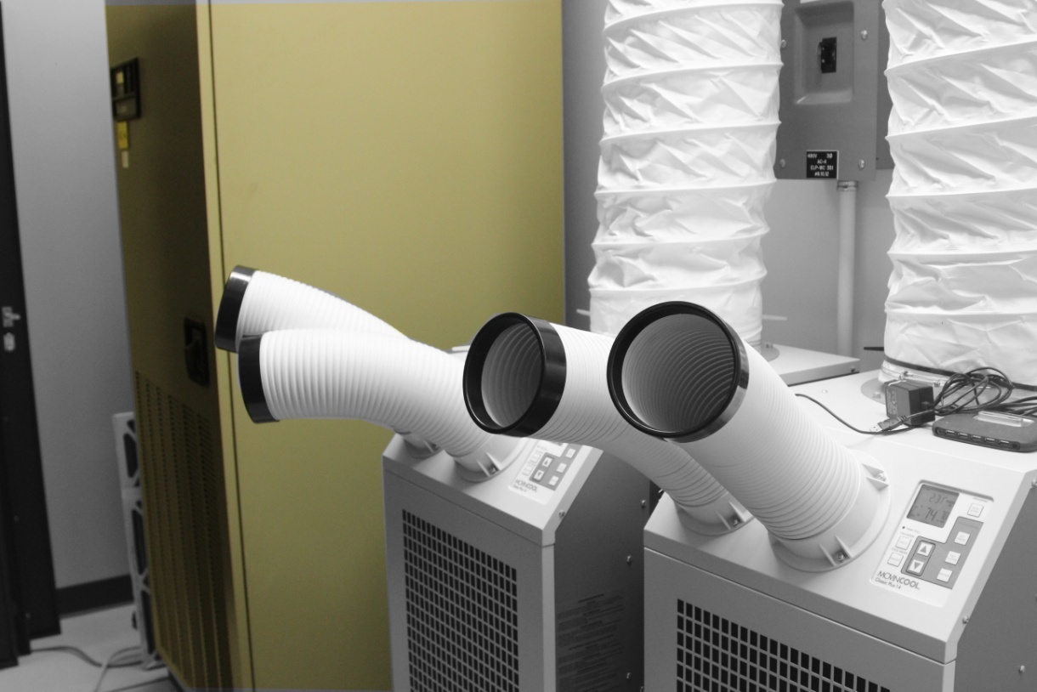
Background – Why it Matters
Current server rooms only have one HVAC per room
2 is optimal for redundancy
Quick response system is needed for protection
1 hour max delay before critical emergency
Any increase in temperature reduces life expectancy of equipment
Notes:
redundancy
2 havc’s – explain that they had an issue in a room with 1 hvac – it had to be replaced, have to shut the whole server down for a weekend, if they had 2, 100% uptime
2 hvac’s – if one fails, it keep the room cool

Slide 9
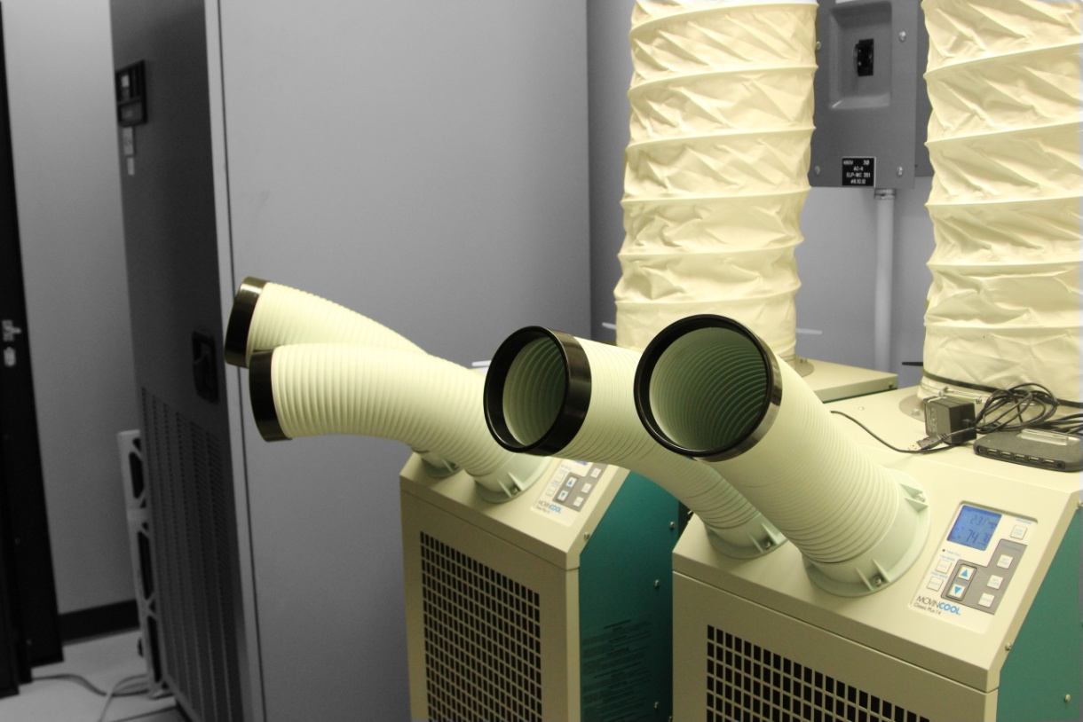
Background – Why it Matters
Current server rooms only have one HVAC per room
2 is optimal for redundancy
Quick response system is needed for protection
1 hour max delay before critical emergency
Any increase in temperature reduces life expectancy of equipment
Notes:
redundancy
2 havc’s – explain that they had an issue in a room with 1 hvac – it had to be replaced, have to shut the whole server down for a weekend, if they had 2, 100% uptime
2 hvac’s – if one fails, it keep the room cool

Slide 10
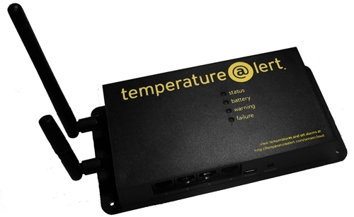
Background – Sensing Setup
1 Temperature@lert sensor in each server room.
Too few sensors relative due to the high cost of equipment
No central management Server (requires manual checking)

Slide 11
Background – Previous Team
Developed site that communicates with current sensors.
Features include room/group management and user authentication with permission levels
Sensors report only real-time temperature

Slide 12
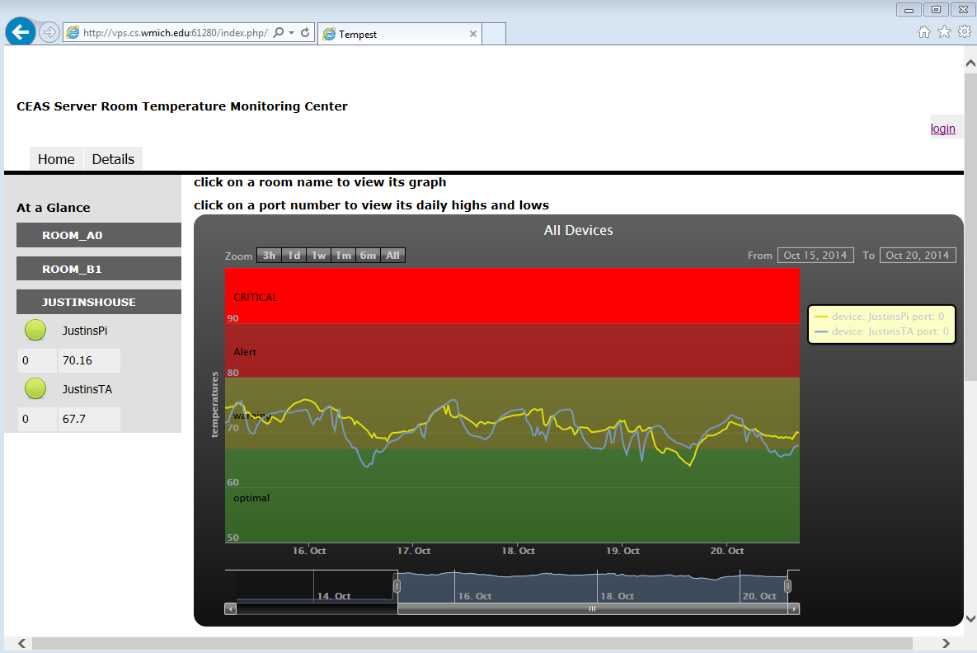
Background – Previous Site
Picture of site on desktop old site and new with bootstrap

Slide 13
Background – Unmet Needs
Central remote data access
Ability to connect to sensors other than Temperature@lert
External site in case of internal network failure
In-house built sensors that are
Extensible
Low-cost
Modifiable
Open source
Record historical data
Monitor multiple rooms
Text/e-mail alerts in warning/critical situations
Notes:
Stress project goals

Slide 14
Design Decisions

Slide 15
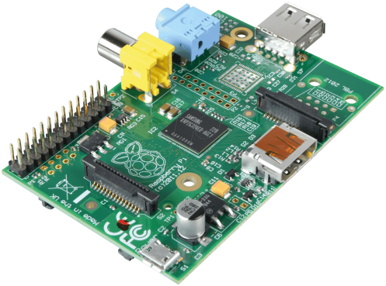
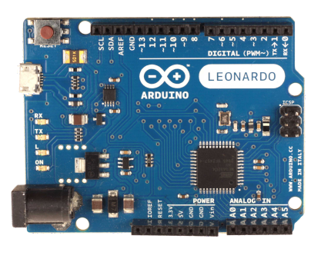
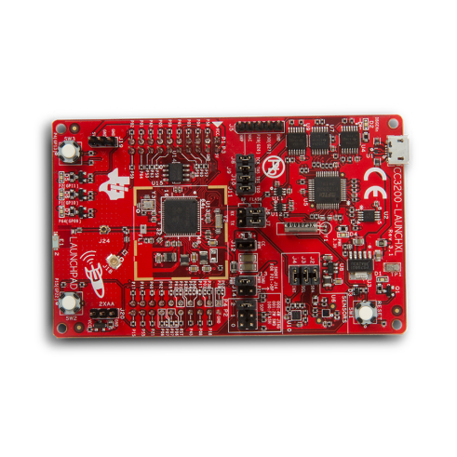
Design Decisions - Hardware
Raspberry Pi
Higher cost
Readily Available
Extensible to 17 sensors
Maximum features
Arduino
Lower cost
Widely documented
Minimal features
MSP430
Lowest cost
Minimal features
Notes:
All of these would work well, but rasp pi works the best

Slide 16
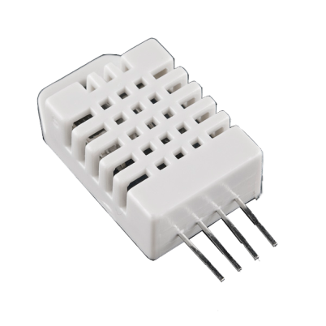
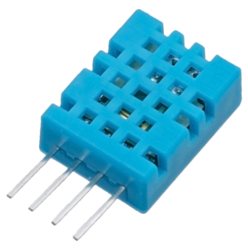
Design Decisions - Hardware
DHT22 Sensor
Temperature Accuracy ±0.5º C
Temperature Range -40 to 80°C
Humidity Accuracy ±0.1Φ
Humidity Range 0-100%
DHT11 Sensor
Temperature Accuracy ±2º C
Temperature Range -0 to 50°C
Humidity Accuracy ±5%
Humidity Range 20-80%
Notes:
Φ is relative humidity
Web server - debugging

Slide 17
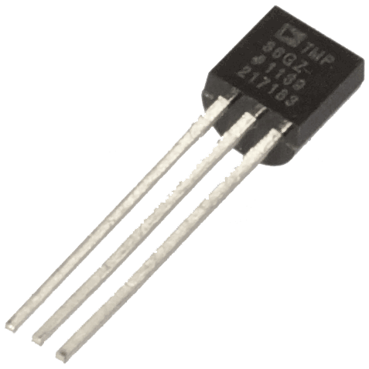
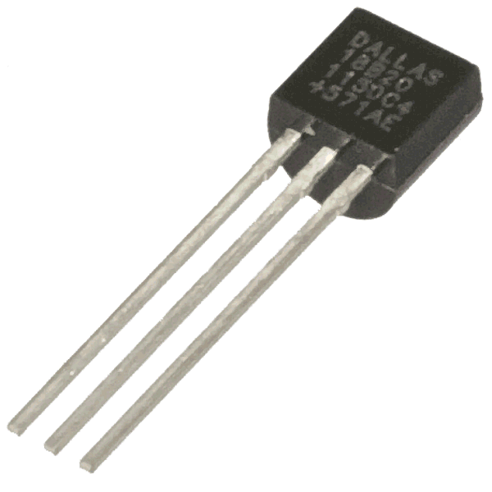
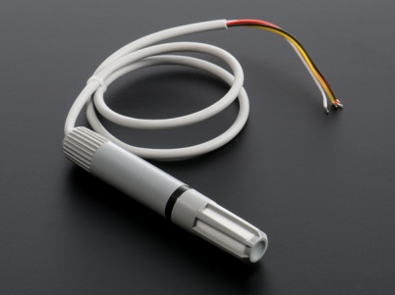
Design Decisions - Hardware
TMP36 Sensor
Analog
Doesn’t detect humidity
DS18B20 Sensor
Digital
Doesn’t detect humidity
AM2315
Digital
$30 is too expensive
Notes:
Φ is relative humidity
Web server - debugging

Slide 18
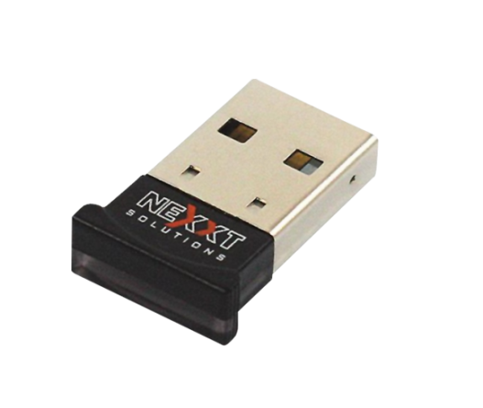
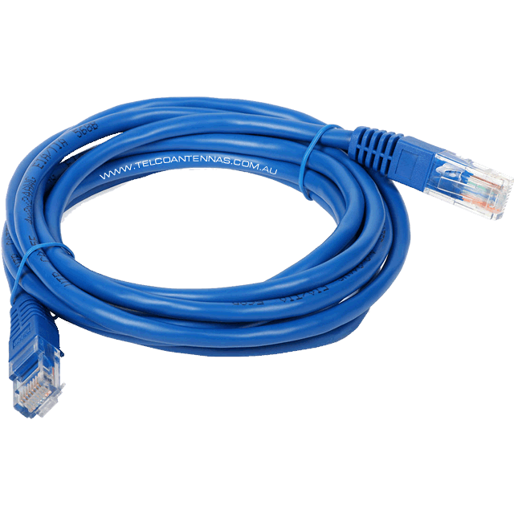
Design Decisions - Hardware
Wireless N adapter
Long range
Low price
Supports N/G/B/A
Wired
PoE possible but expensive
Requires cable to be run
Less convenient
Notes:
Client WANTED wireless.

Slide 19


Design Decisions - Environment
Laravel
Open source
Most popular PHP framework
Secure
Reliable MVC
Alternatives Include
Ruby on Rails
Raw PHP
Tomcat
Cake PHP
Externally Hosted
Safe off-site location
Easy maintenance
Client Required
Notes:
Client already supports – laravel adds maintainability because it’s so widely used and under continuous upkeep for patches, security fixes, etc

Slide 20
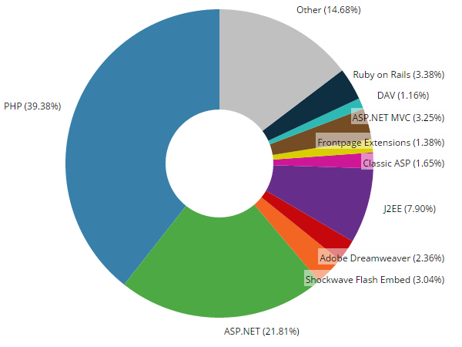
Web Framework Market Share
Notes:
Pi – cheap, overnightable from

Slide 21
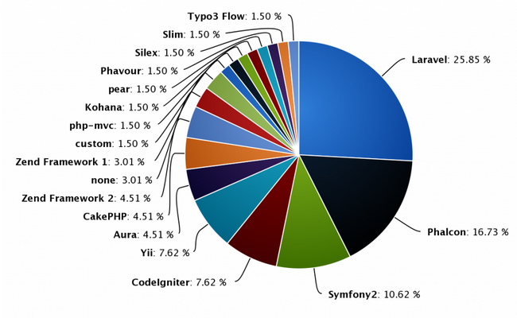
PHP Framework Market Share
Notes:
none

Slide 22


Design Decisions - Language
Sensor driver we chose: Python
Slow
Extremely reliable
Doesn’t need compilation
Sensor driver we didn’t choose: c
Fast
Needs compilation
Doesn’t run too well with DHT sensors
Web Site
LAMP Stack
Laravel Framework
Notes:
LAMP – elaborate to it standing for linux, apache2, mysql, php – all open source, free, secure, fast, reliable
Laravel – secure,

Slide 23

Design Decisions – Site Host
Amazon Web Services
Easy to migrate
Free for a year
Unlimited Bandwidth
Alternatives
Azure
Linode
DigitalOcean
$10 a month after free period
VM is transportable
Reliable – 99.95% uptime
Notes:
LAMP – elaborate to it standing for linux, apache2, mysql, php – all open source, free, secure, fast, reliable
Laravel – secure,

Slide 24


Design Decisions - Improvement
Bootstrap
Open source
Well Documented
Tablet and Phone Support
Alternatives
jQuery Mobile
Foundation
High Charts
Updated version for mobile support
Scales well and looks much cleaner
Alternatives
Google Charts
Yahoo User Interface Library
Chart.js
Notes:
bootstrap vs foundation vs jquery mobile. Went with bootstrap because it was easy, pretty, little to no work to make work, bootstrap offered much more styling, it's scaffolding seemed to fit in with laravel's coding easily. We really just wanted a scaffolding option and in that sense it seemed as well as foundation and jquery mobile, but I had previous experience with bootstrap so I quickly added it with no learning curve.
google charts vs highstocks–it came down to a late design decision. Google charts was our choice initially because of it's ease, but it required data in a very specific format, and with MySQL lacking a pivot option, it would have taken a significantly greater amount of time to code for google charts, and highstocks/highcharts took pretty much any data and ran with it.

Slide 25
Design

Slide 26
Design
Room A
Linux
Pi
User
Temp@lert
Room B
Pi
Notes:
se

Slide 27
Design
Linux
Device
xml
Apache
Rasp Pi
Laravel
Sensor
PHP
mySQL
Notes:
se

Slide 28
Design – Pi and Sensor Communication
Device
Uses Python to communicate to the device
Python sends a request
Sensor responds
Output written to XML file
Rasp Pi
Sensor

Slide 29
Design – Pi and Server Communication
Apache hosts XML file for server to retrieve
Server has different drivers for different devices
Parses XML according to driver
Temperature information handled by server
Linux
Apache
Laravel
PHP
mySQL
Notes:
Admin choose refresh interval – 1 minute, 2 minute, 5, 10 etc
Apache hosts, server fetches, server stores in mysql, server queries database for specified drivers with time range, laravel preprocesses php, bootstrap renders based on device

Slide 30
Design – Users and Rooms
Two current user roles
Admin
Permissions to create/edit/delete users/devices/rooms/etc
User
Permission to view only
Creates
Assigned To
Admin 1
User 1
Room 1
Admin 2
User 2
Room 2
User 3
Room 3
Room 4

Slide 31
Implementation

Slide 32
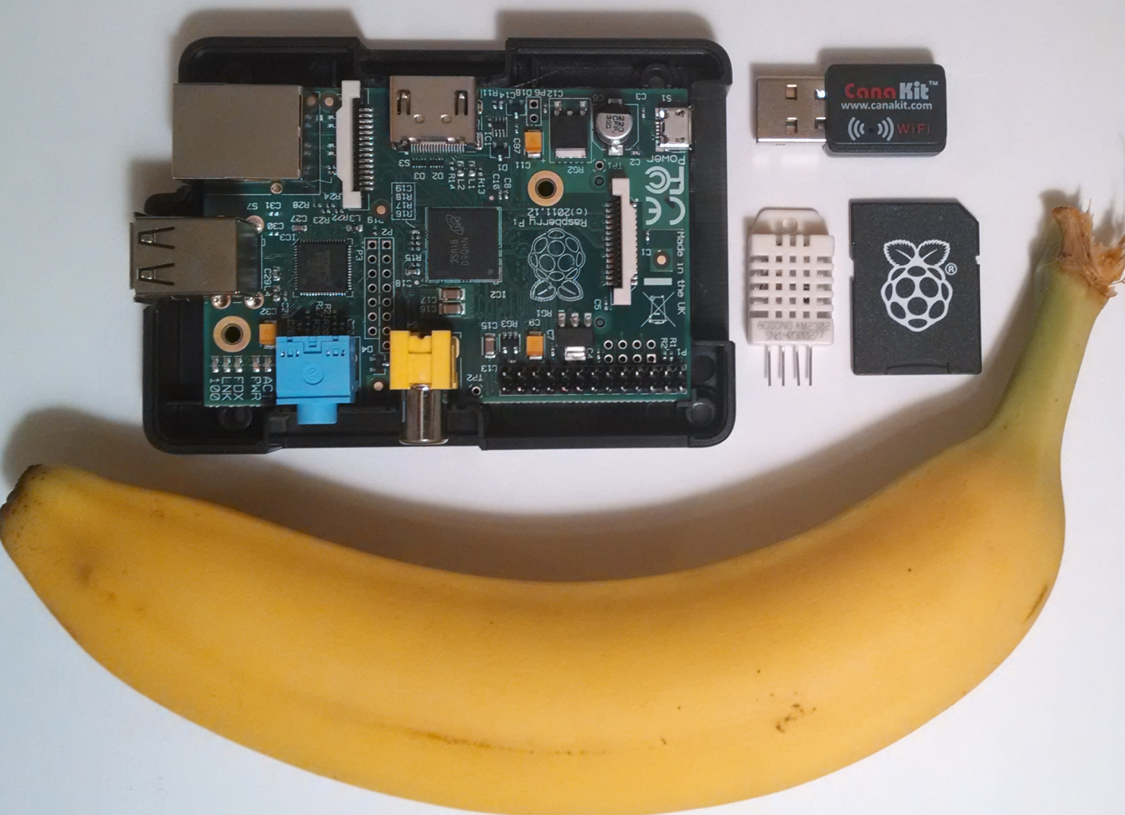
Implementation
Banana for scale.

Slide 33
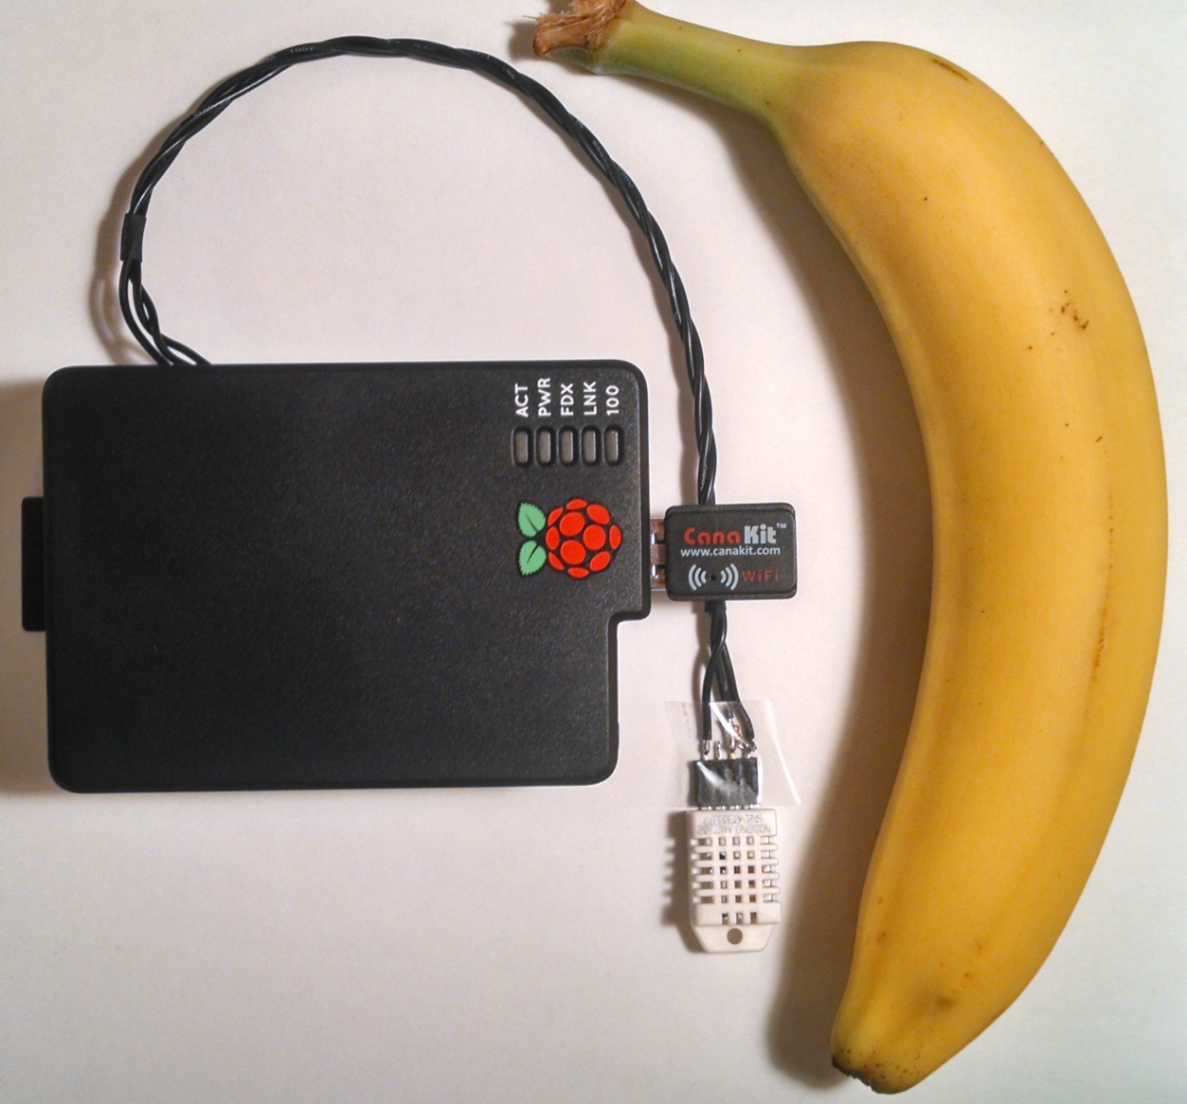
Implementation

Slide 34
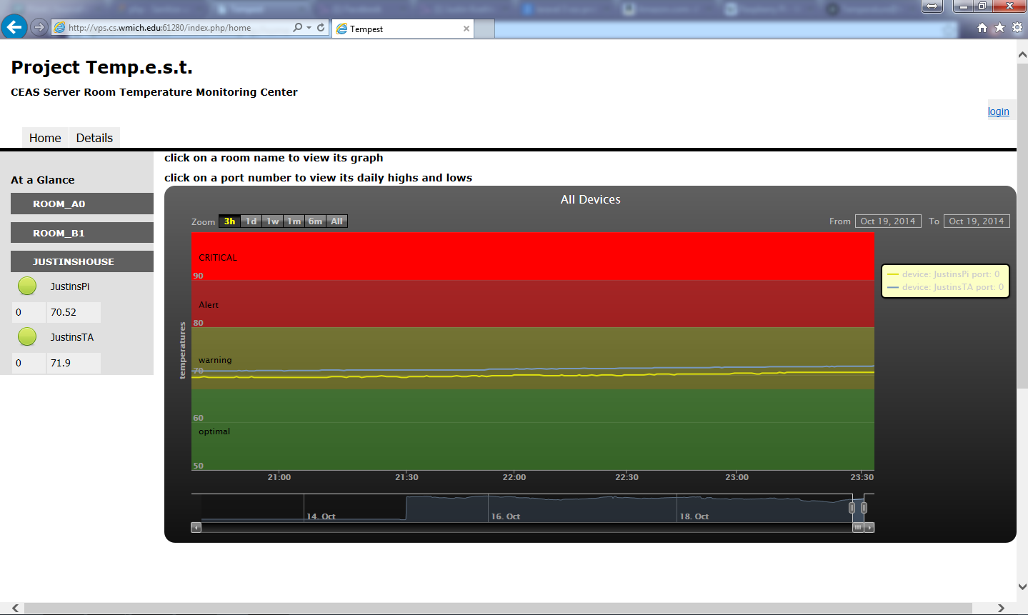
Implementation – Desktop (before)
Picture of site on desktop old site and new with bootstrap
Notes:
Get a new picture, sucka

Slide 35
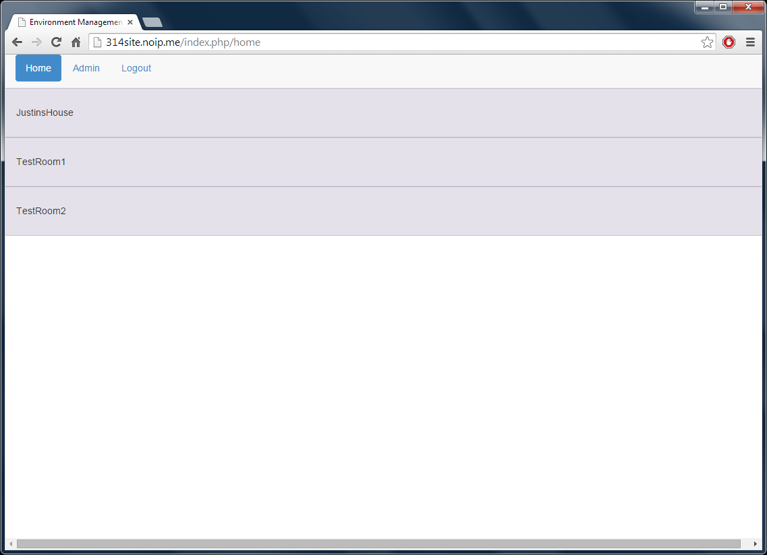
Implementation – Desktop (after)

Slide 36
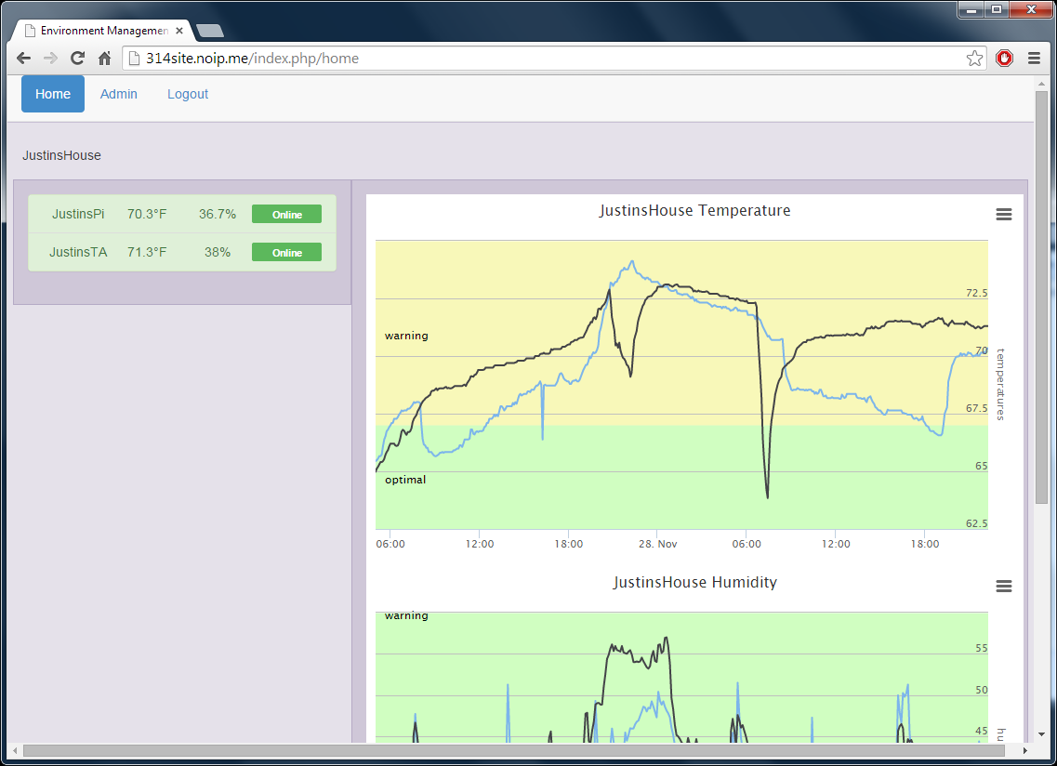
Implementation – Desktop (after)

Slide 37
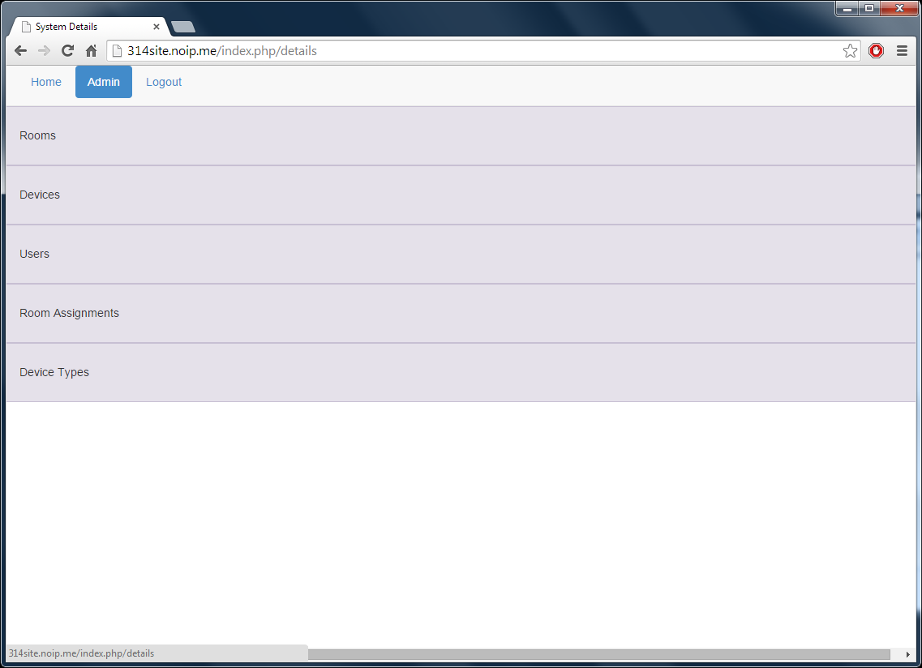
Implementation – Desktop (after)

Slide 38
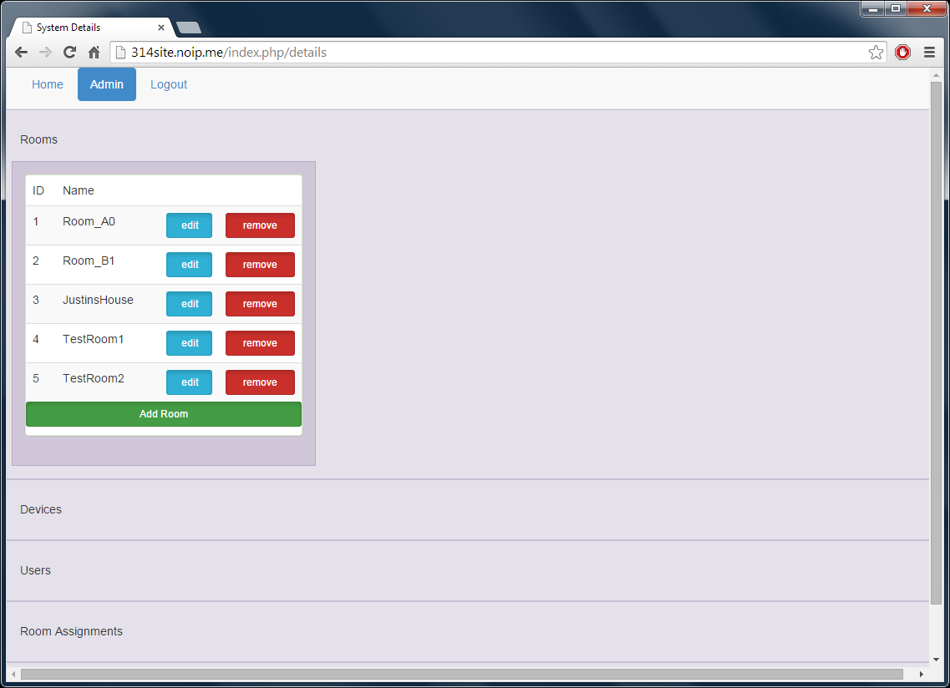
Implementation – Desktop (after)

Slide 39
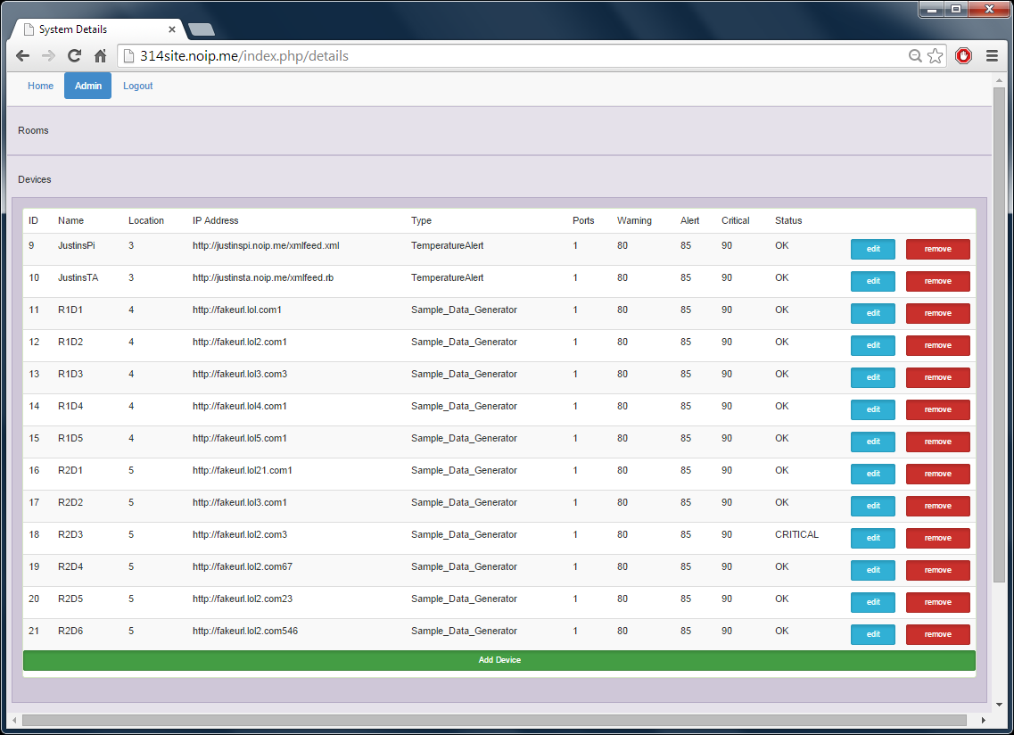
Implementation – Desktop (after)

Slide 40
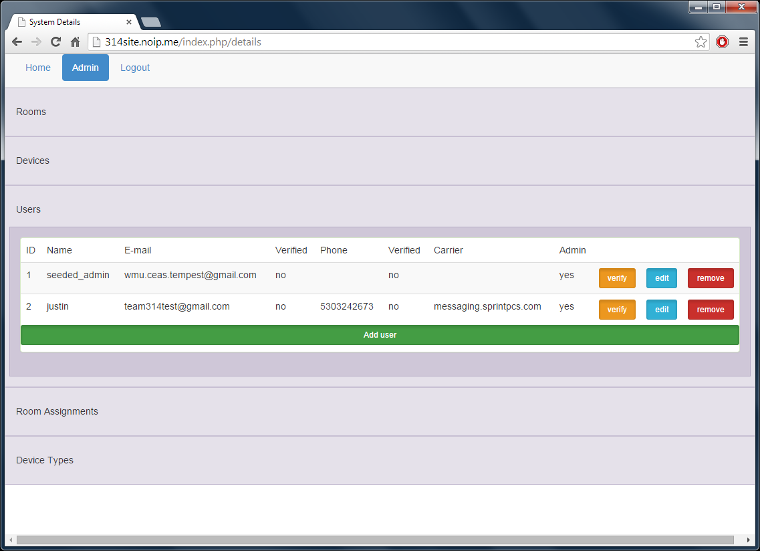
Implementation – Desktop (after)

Slide 41
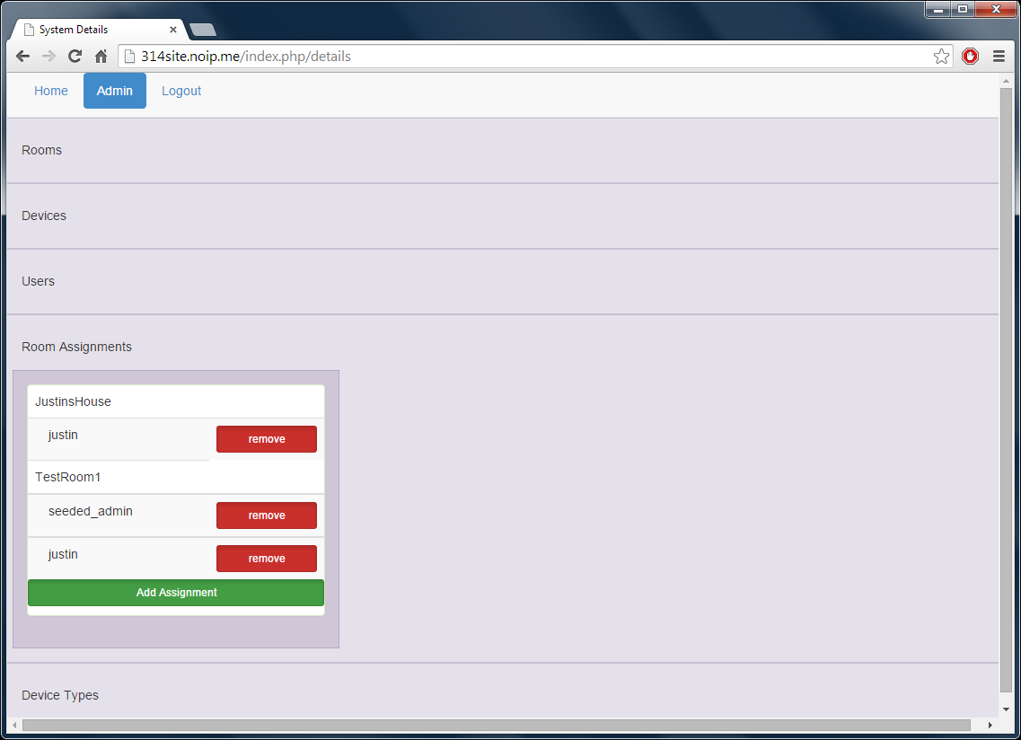
Implementation – Desktop (after)

Slide 42
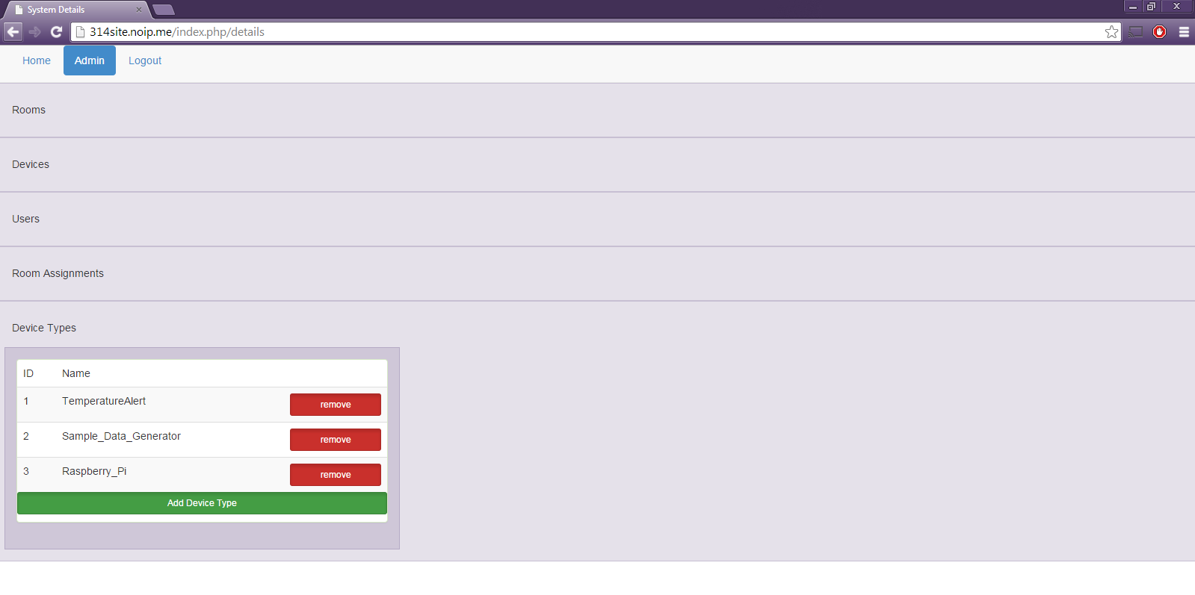
Implementation – Desktop (after)

Slide 43
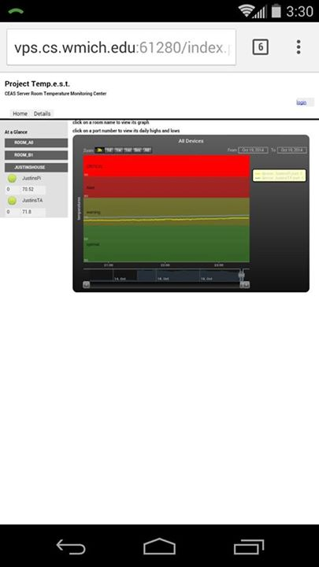
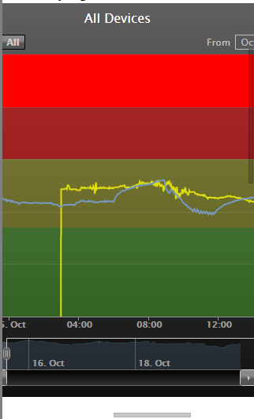
Implementation Before Bootstrap on Mobile

Slide 44
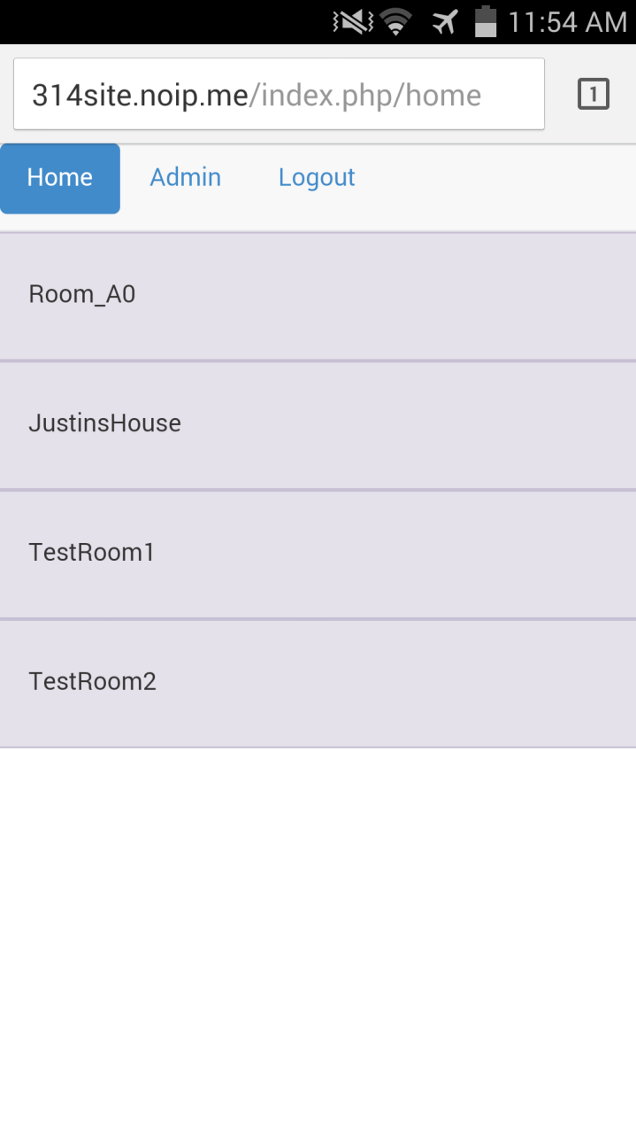
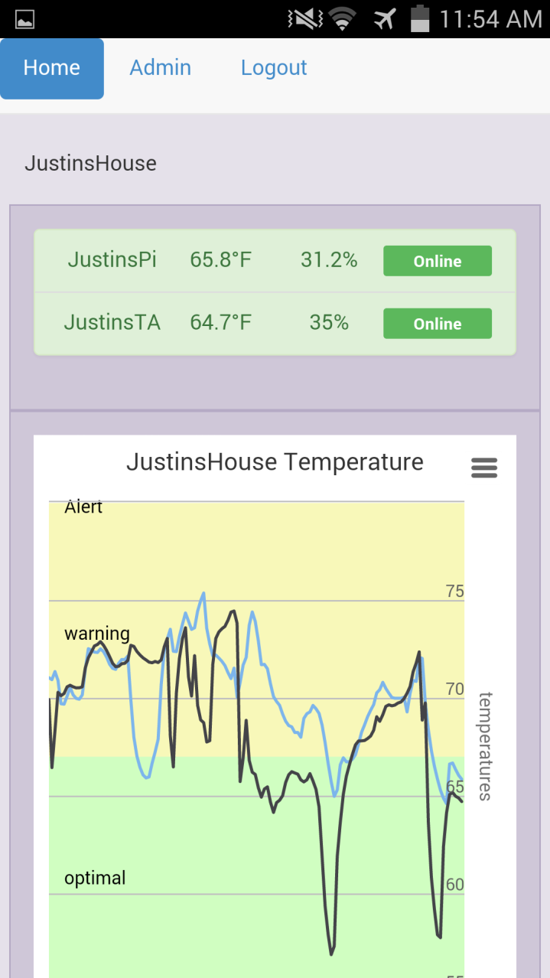
Implementation After Bootstrap on Mobile

Slide 45
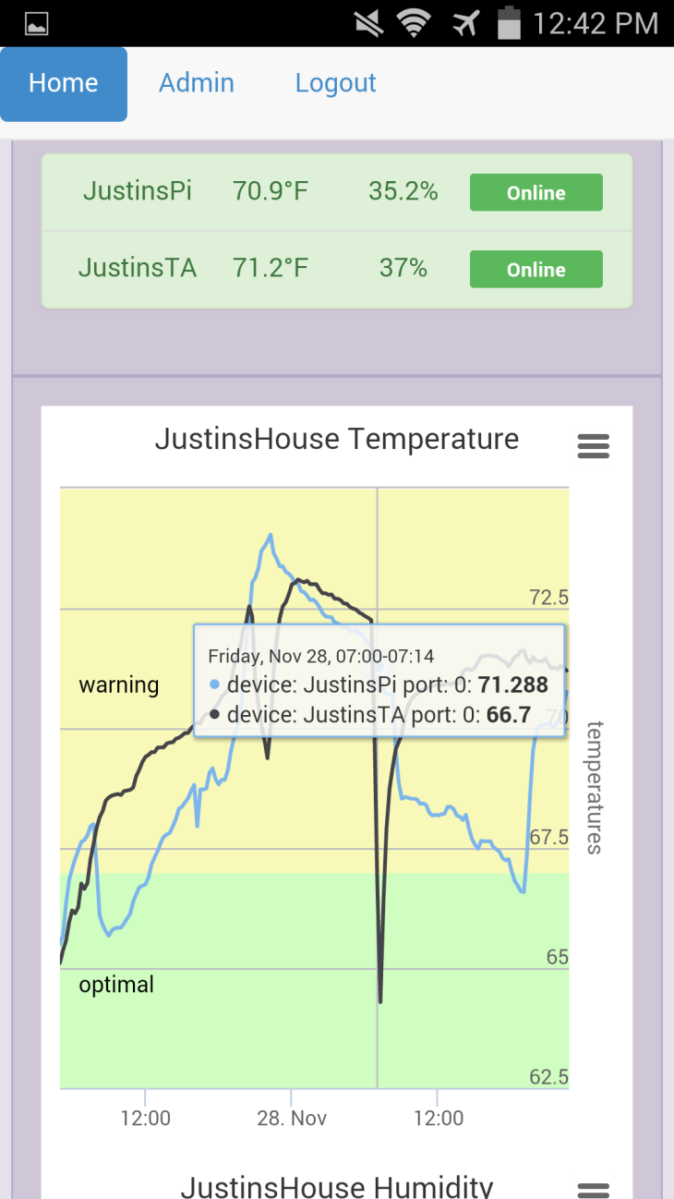
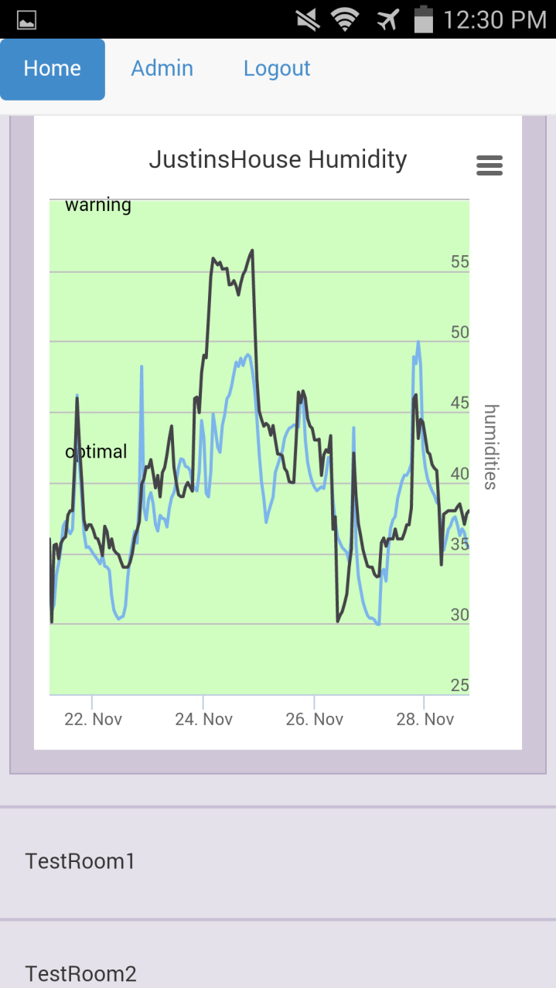
Implementation After Bootstrap on Mobile

Slide 46
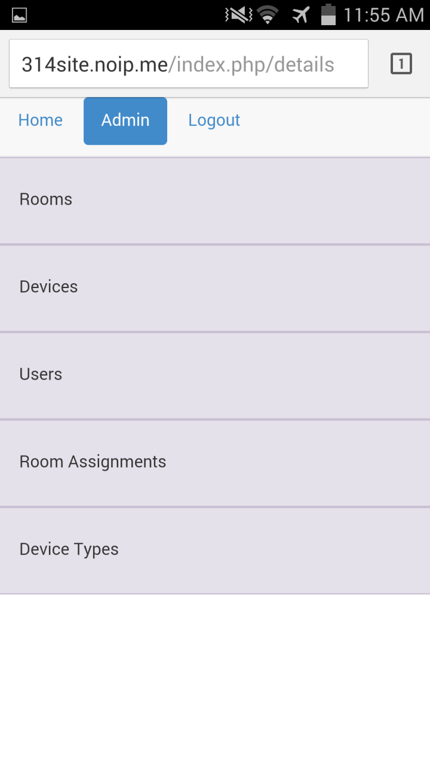
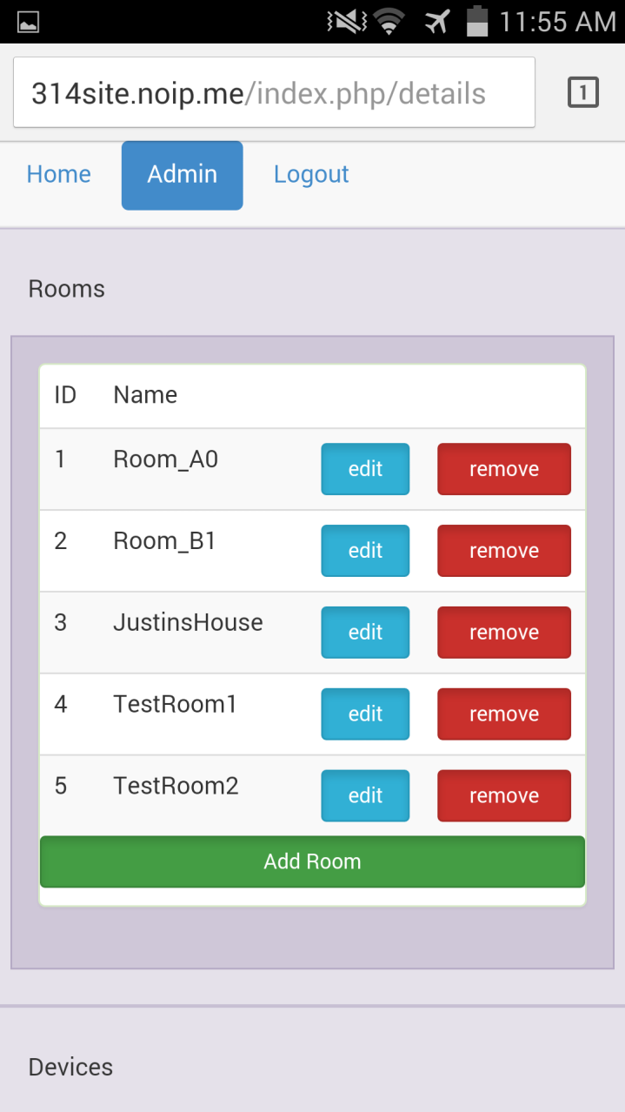
Implementation After Bootstrap on Mobile

Slide 47
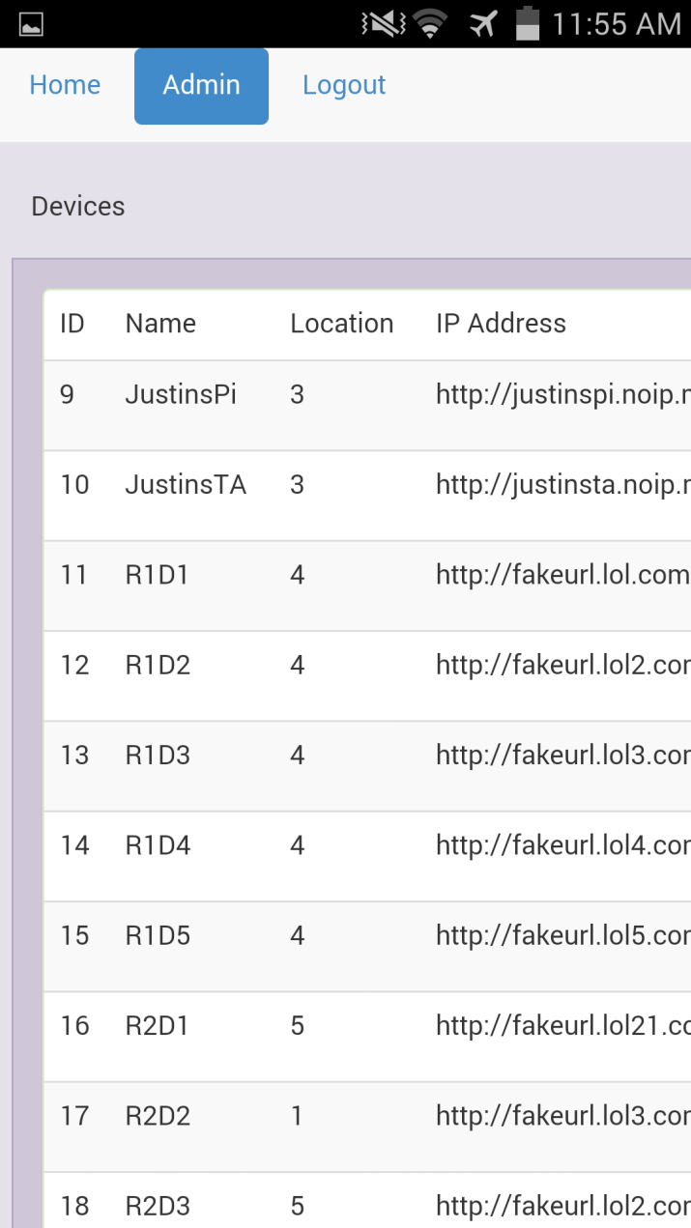
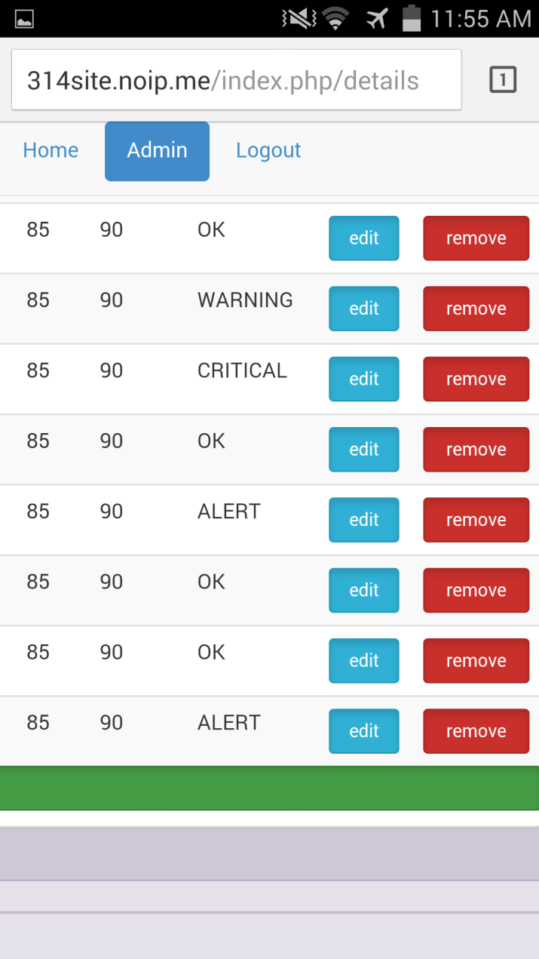
Implementation After Bootstrap on Mobile

Slide 48
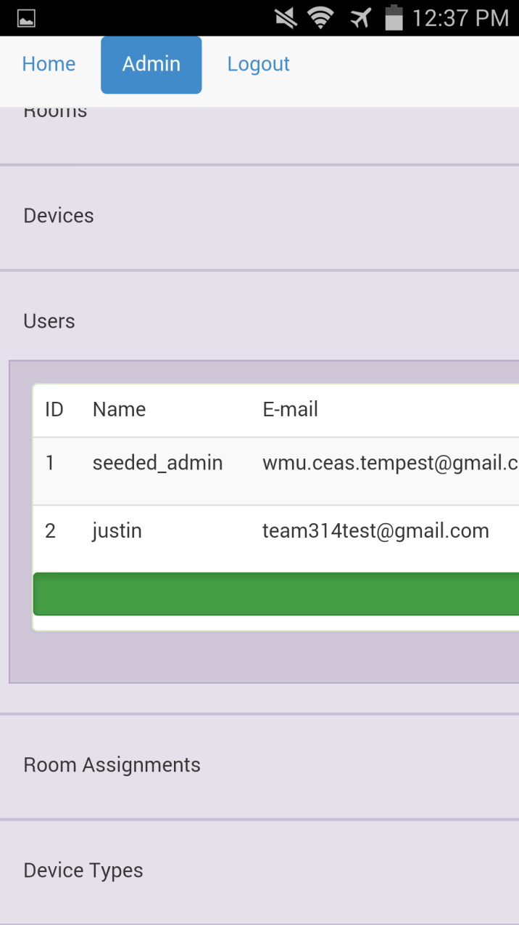
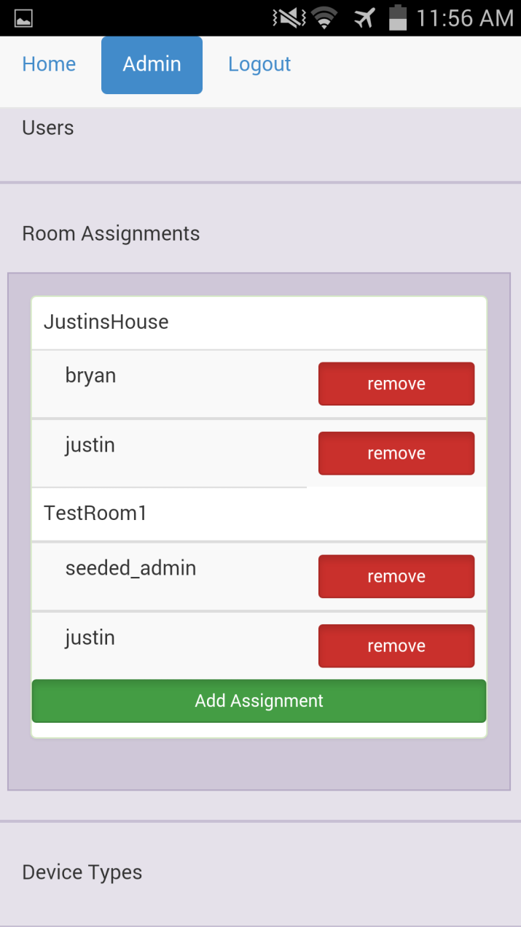
Implementation After Bootstrap on Mobile

Slide 49
Testing

Slide 50

Testing – What Was Used
Laravel built in testing framework
Additional PHP testing with PHPUnit
10 virtual sensors for testing
Notes:
P-unit logo
Add testing room, add testing devices, write testing code

Slide 51
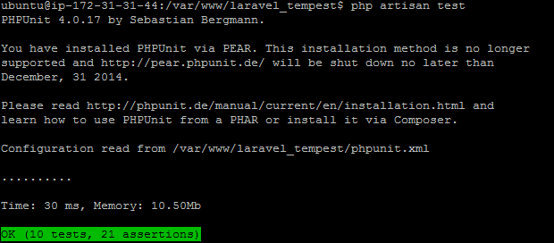
Testing – Passed Test
Notes:
P-unit logo
Add testing room, add testing devices, write testing code

Slide 52
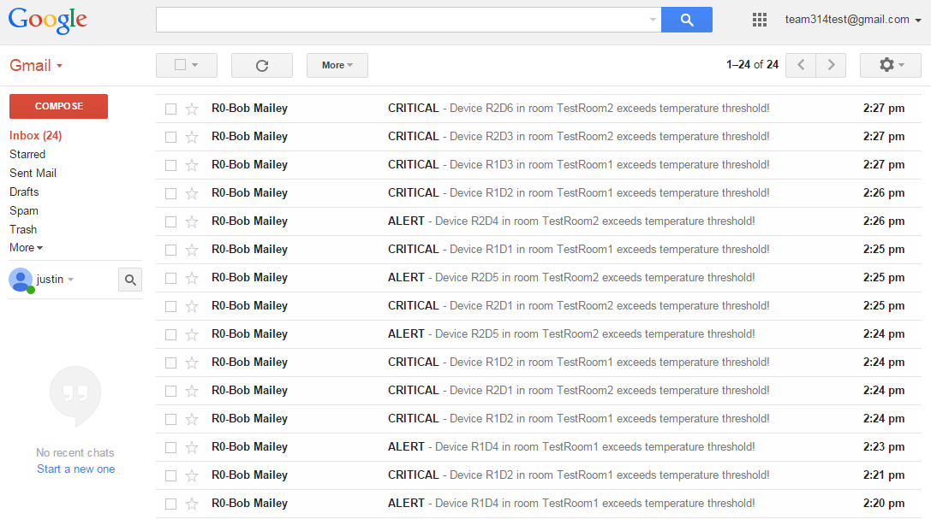
Testing – Email Alerts

Slide 53
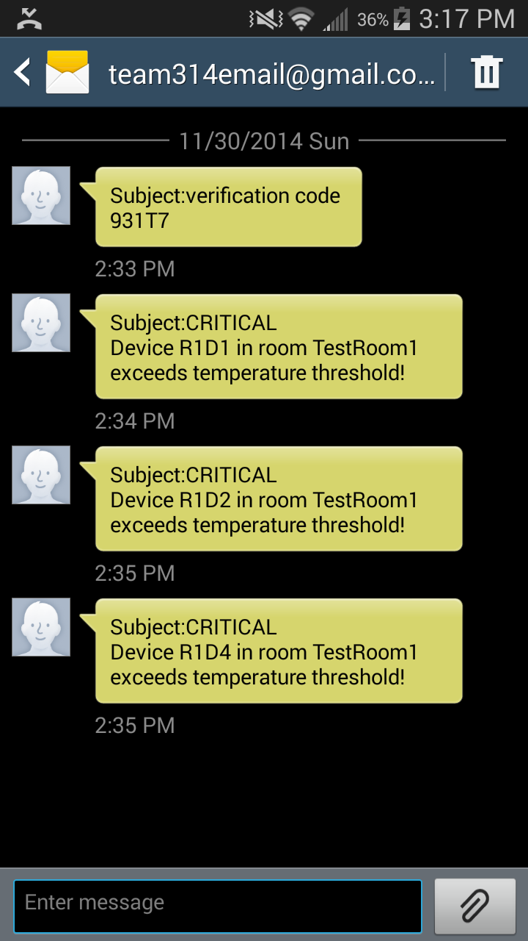
Testing – Text Messages

Slide 54
Security

Slide 55
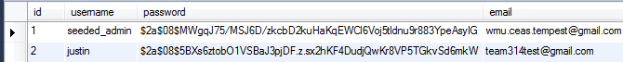
Security
Laravel
Sessions
Tokens
Input Sanitization
XSS
SQL Injection
Password Hashing

Slide 56
Maintenance

Slide 57
Maintenance
All code available on GitHub
Maintenance will be performed by WMU staff
Repository will be transferred to Dr. Kapenga
User manuals on setup and usage process
Notes:
Our client is an open source advocate, prefers to have code available on an open source repository

Slide 58
Maintenance – Future Releases
Pi Logging in case of network failure
Server fetch of historical data from Pi
Pi interfacing with GPU/CPU/other
User groups
Master Admin
SSL
Race conditions

Slide 59
Summary

Slide 60
Summary
Our device is more extensible
Our device cost breakdown as currently tested
$ 35.00 for the raspberry pi
$ 6.26 for the sensor
$ 8.70 for the wireless adaptor (optional)
$ 5.95 for the SD card
$ 6.67 for the AC Adapter
$ 62.58 total plus miscellaneous parts for in house sensor
$299.99 Temperature @lert wifi edition sensor
Our setup has a offsite central server so that issues with one sensor do not affect ability to see temperature data
Notes:
Cheaper in bulk misc parts being cables and resistor power cable

Slide 61
Questions?

